Slide 1
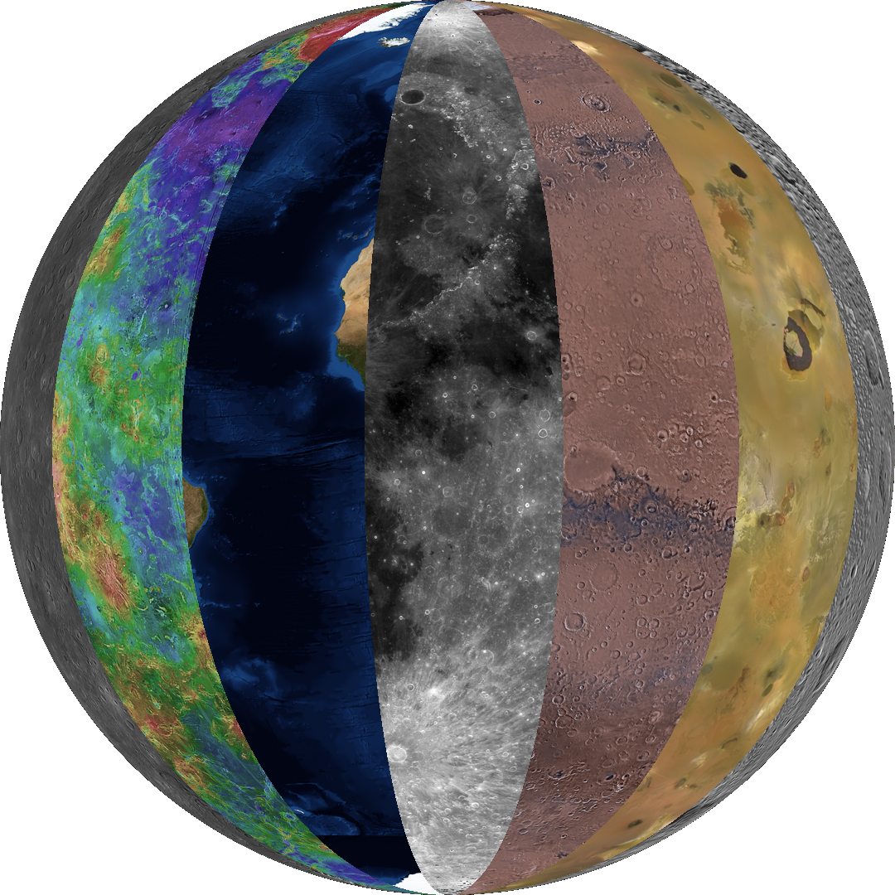
LUNASERV: Adding a geospatial FRAMEWORK to Apollo sampleS
LUNASERV
Your data, your way
dR. Samuel Lawrence
sESE, ASU
Nick Estes
SENIOR SYSTEMS ANALYST, LROC SOC, Arizona State University
ERNEST CISNEROS
OPERATIONS MANAGER, LROC SOC, ARIZONA STATE UNIVERSITY

Slide 2
What is Lunaserv?
Lunaserv is a custom-built Web Map Service with native support for planetary IAU projections
Not a data portal – Lunaserv is a WMS geospatial content delivery system service
Key part of infrastructure for LROC Science Operations
LROC SOC is a PDS Data Node and Lunaserv is the public-facing geospatial data delivery system
Also used for internal targeting operations and science team research
Ease of use provides flexibility for time-critical mission operation tasks and was a major design focus of the Lunaserv platform
Compatible with JMARS desktop software, QGIS, ArcMAP, etc. – any desktop client that can access the WMS standard
Free and Open Source
Also used by the ISS Earth Observing team to serve Crew Earth Observations and other ISS remote sensing data in a geospatial framework
http://issearthserv.jsc.nasa.gov/i4.html
For more information, visit: http://lunaserv.lroc.asu.edu/
LUNASERV
Your data, your way

Slide 3
Service Tiers: Definitions
Clients
(Arc/Map, QGIS, JMARS)
Application Services
(HTTP GET/PUT, SOAP)
Open Geospatial Consortium (OGC)
OGC Web Services (OWS) Architecture
http://portal.opengeospatial.org/files/?artifact_id=13140
Processing Services
(WTD, W3DS, WCTS, WICS, CPS)
Information Management Services
Example: LUNASERV
(WMS, WFS, CSW, UDDI)
LUNASERV
Your data, your way

Slide 4
PROTOTYPE APOLLO SAMPLE GEOSPATIAL FRAMEWORK
Goal is to place Apollo samples into a contextualized geospatial framework
WMS compatible data service is platform independent, simplifies interface, broadens possible tools
New paradigm for extraterrestrial sample context
Flexible
Easy to update
Scalable for future growth
Building on Lunaserv platform, requires <1 workday (8 person-hours) of effort
Data used for this Proof of Concept:
ASU Apollo Digital Petrographic Slide Collection (Howard Wilshire, USGS)
See http://ser.sese.asu.edu/DPSC/about.html
LROC PDS-released data (LRO NAC and WAC) – global to m-scale data from Moon through last PDS release
Ultimate goal is to seamlessly combine the km-scale global images with the micron-scale petrology to enhance science and exploration
LUNASERV
Your data, your way

Slide 5
User Interface Tour
Each ASU DPSC slide has been assigned to station number and mission locations for each Apollo landing
Location “eyeballed” – full-scale effort would require manual control and historical expertise
User activates DPSC query layer
Note positions
of Apollo landing
sites – user queries
with mouse

Slide 6
Example: Apollo 11
Result of user query for samples collected near lunar module on Apollo 11
Notes:
Note Neil Armstrong’s footpath; map-projected LROC NAC frame accessed through Lunaserv WMS online interface.

Slide 7
From DPSC layer, user can access images and data about a given sample straight from the geospatial framework
LUNASERV
Your data, your way

Slide 8
SUMMARY
The Lunaserv platform enables seamless integration of km-scale imagery and mm-scale Apollo sample data
This proof-of-concept built on existing technology framework is functioning right now
JSC Astromaterials Research and Exploration Science is interested in using this tool to provide access to extraterrestrial sample data (e.g., in the Apollo Sample Compendium)
PDART MoonDB project (K. Lehnert, Columbia Univ.) is working with ARES to provide access to sample compositional data from laboratory PIs
This effort links sample compositional information with surface & subsurface geospatial information
With addition of PDS data formatting, labels and documentation, access to the Apollo sample data will be significantly enhanced and more usable
LUNASERV
Your data, your way

