Slide 1
Europa Mission
Lisa Gaddis (USGS, Astrogeology)
PDS Cartography and Imaging Sciences Node
(You can still call us “Imaging” or PDS-IMG or IMG)

Slide 2
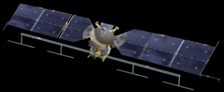
Europa Mission Interface
Mission Status
Instruments
PDS Current Status:
Node Assignments
Identify Lead Node, Instrument Support Nodes

Slide 3
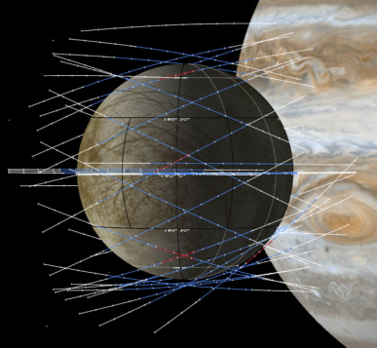
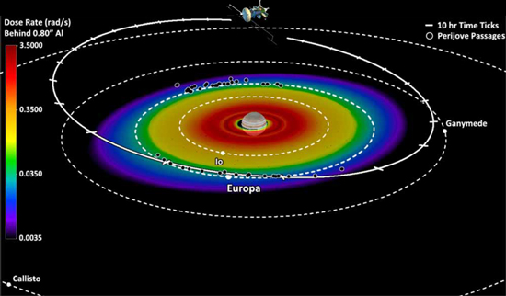
Europa Mission
Now called “Europa Multiple Flyby Mission”
Europa Clipper Orbiter and a Lander
Explores potential for subsurface ocean & habitability on Jupiter’s moon Europa
Ice shell and ocean, composition, geology
Performs 45 close flybys of Europa from orbit around Jupiter
Topographic survey, ice thickness, plumes?
7 to 10 days to transmit data between flybys
Solar powered
Joint investigation between JPL & APL
Nine instruments on orbiter
Nanosatellites for plume samples?
Lander configuration is TBD

Slide 4
Europa Clipper Orbital Instruments
PIMS: Plasma Instrument for Magnetic Sounding
PI: Joseph Westlake, APL
ICEMAG: Interior Characterization of Europa using Magnetometry
PI: Carol Raymond, JPL
MISE: Mapping Imaging Spectrometer for Europa
PI: Diana Blaney, JPL
EIS: Europa Imaging System
PI: Elizabeth Turtle, APL
REASON: Radar for Europa Assessment and Sounding: Ocean to Near-Surface
PI: Donald Blankenship, Univ. Texas
E-THEMIS: Europa Thermal Emission Imaging System
PI: Philip Christensen, Arizona State Univ.
MASPEX: Mass Spectrometer for Planetary Exploration/Europa
PI: Jack Waite, Southwest Research Institute
UVS: Ultraviolet Spectrograph/Europa
PI: Kurt Retherford, SWRI
SUDA: Surface Dust Mass Analyzer
PI: Sascha Kempf, Univ. Colorado, Boulder

Slide 5
EMF Mission: Lander
Still under development
Europa Clipper Orbiter would image the surface over 3 years (95% coverage, 50 m/pixel) to help identify a landing site
1-Meter in diameter, 230 kg, 30 kg for instruments
Possible instruments:
Mass spectrometer
Raman spectrometer
Sky crane landing system?
10 days of surface operations (battery power)
Active crevasse site?

Slide 6
EMF Mission: Notional Timeline (?)
Still under assessment
Atlas V 551 rocket >> 6 years transit time
Space Launch System (SLS) >> 3 years transit time
Launch 2022 to 2025 (in ~6 to 9 years)
Mission duration: 3 to 5 years?

Slide 7
EMF Mission: TBD for PDS
Identify Lead Node
Assign Instrument Nodes
Draft schedule, contact Pappalardo (JPL)
Establish DAWG, move into archive operations

Slide 8
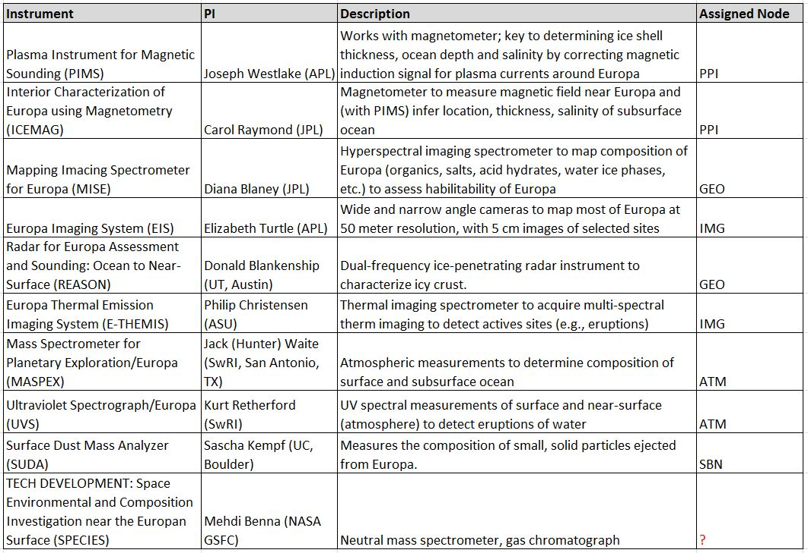
EMF Instruments & PDS Nodes

Slide 9
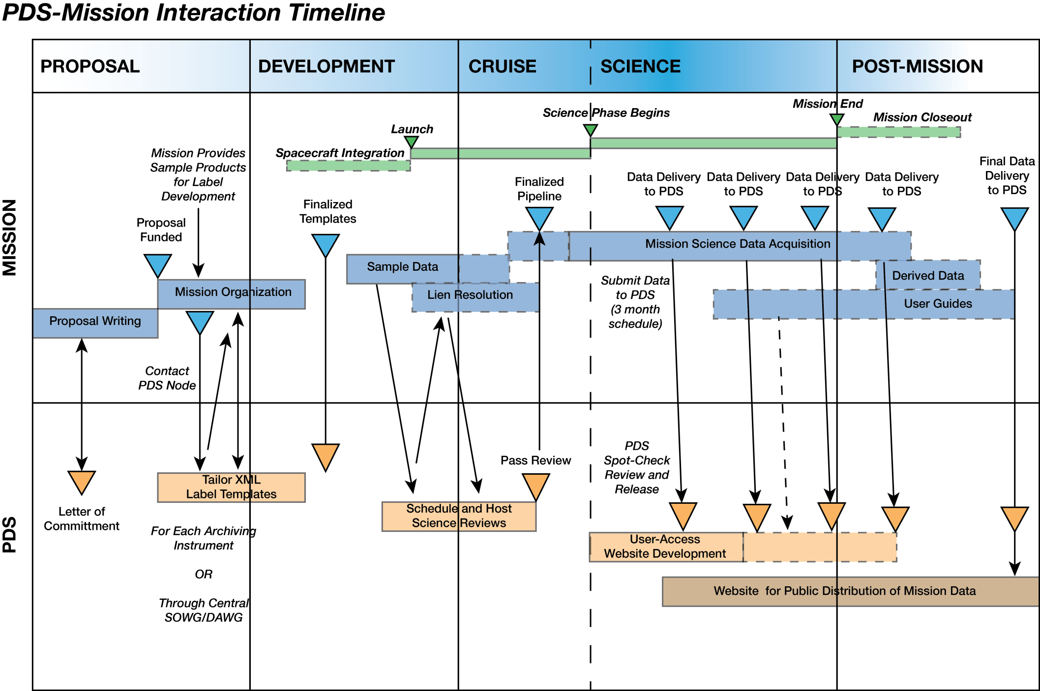
Typical Mission & PDS Timeline

Slide 10
Mission: Proposed Archiving Schedule
Now (Current date) | Start DAWG meetings Start draft of Archive Plan Start drafts of ICDs
Mission PDR (Date, ~1.5 yrs later) | Preliminary DMAP (Archive Plan) completed Draft ICD for each instrument completed E2E Peer Review??
Mission CDR (Date, ~1 yr later) | Final Archive Plan completed Final ICDs completed Draft SIS documents completed Start peer reviews of instrument data products
Launch minus 6 months (Date, ~2 yrs later) | Final SIS documents completed Peer reviews complete
Launch (Date, ~2 yrs later)
TBD | First data acquisition period – 30 days or 3 months
TBD | First data release – end of data acquisition + 3 months (Meets Level 1 reqt to archive data in <6 months after receipt)
TBD | Subsequent releases – every 3 months

Slide 11
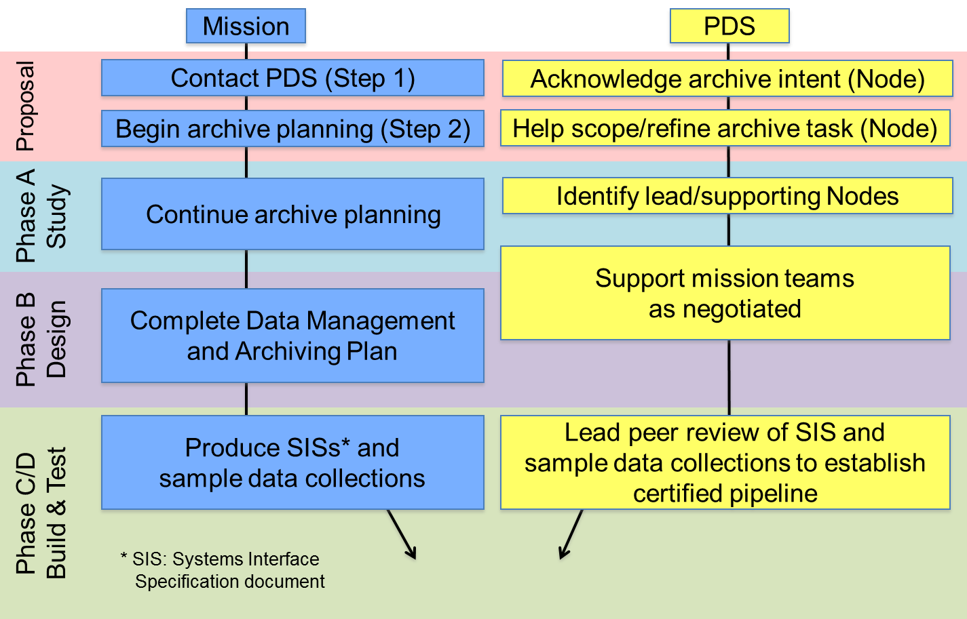
PDS Archive Process

Slide 12
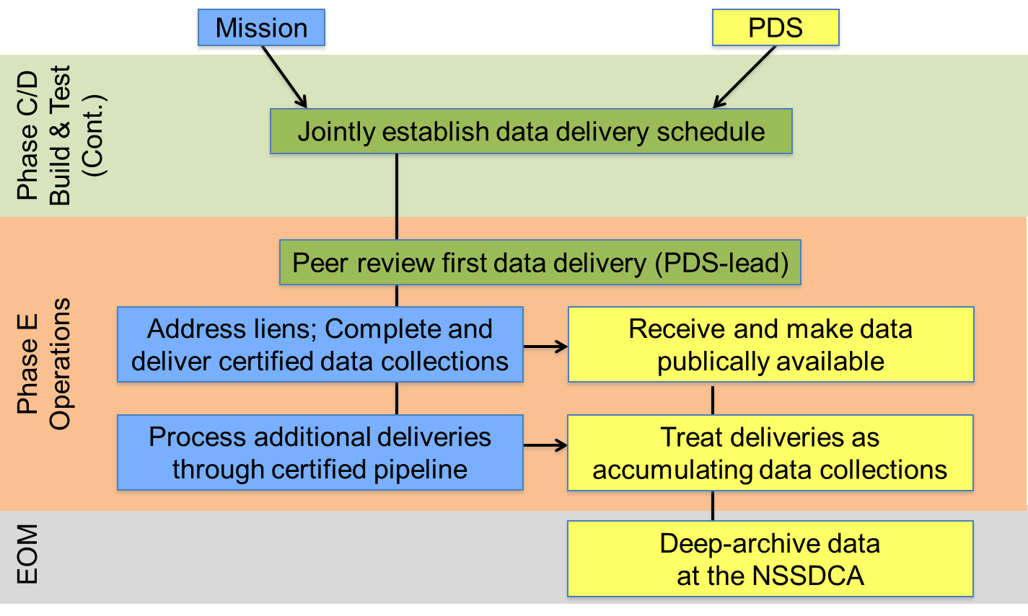
PDS Archive Process

