Slide 1
NSSDCA Status
Dave Williams
PDS Management Council
UCLA
4-5 February 2016

Slide 2
PDS Delivery Status Overview
Registered 41 volumes submitted by ATMOS (33), IMG (6) and PPI (2) since last MC meeting.
No PDS3 compliancy issues. Thanks!
Node deliveries since last MC meeting:
ATMOS: 1 media delivery, 2 network deliveries
IMG: 1 network delivery, 1 NAS delivery
PPI: 1 network delivery

Slide 3
PDS Delivery Status Overview
Ingest and archive: No problems reported.
NSSDCA archiving status reports were sent to each Node’s designated point of contact and manager on January 28.

Slide 4
Network Attached Storage Delivery Status
The 4 Imaging Node LROC volumes delivered in July 2015 using NSSDCA’s NAS have been archived.
The NAS was sent back to the Imaging Node in October 2015.
The NAS containing 6 volumes from the Imaging Node arrived at NSSDCA on February 2.

Slide 5
NSSDCA/PDS Network Capability
NSSDCA network configuration: 10Gb/s connection from servers to a router which connects to Internet2 through a 40Gb/s backbone.
Geosciences is the only Data Node known by NSSDCA to have a similar setup.

Slide 6
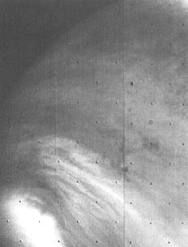
5 February 1974 First Close-ups of Venus Mariner 10
First-ever close-up image of Venus, showing the sunlit limb.
Returned by Mariner 10, 42 years ago today.
UV Mosaic, Feb. 6

