Slide 1
ESDIS TCAT Experience
E. Tauer – JPL / PO.DAAC
February 4th, 2016

Slide 2
Talking points
Executive summary
Context of the review subject: ESDIS DAACs
Overview of ESDIS
Overview of a DAAC
TCAT vs. the E&E Review team
Recommendations (1, 2, and 3)
Context of the solution space:
Breadth of DAAC capabilities
Example of a potential response
A couple lessons learned / parting thoughts

Slide 3
Executive Summary
Technical Capabilities Assessment Team (TCAT) formed in early 2014
Analysis (“deep dive”) of the DAACs spanned a one year period
Result: Assigned ESD/ESDIS to sponsor an independent review team
E&E Review Team formed in April 2015
Three findings/recommendations submitted to ESD in August 2015
Develop prototypes for using cloud environments
Implement common data services and development strategies
Improve processes related to open source software

Slide 4
ESDIS and the DAACs

Slide 5
Earth Science & Data Systems
Applications
C. Dobson
Socioeconomic
Data & Applic-
ations Center
Astro-
physics
SAR Systems
C. Dobson
Applied
Science
L. Friedl
ASF SAR
Data Center
Application Scientists
NASA Headquarters
Science Mission
Directorate (SMD)
J. Grunsfeld
Helio-
physics
Program Scientist for EOS
L. Tsaoussi
Land Processes
W. Turner
Research
J. Kaye
Land
Processes
DAAC
Earth
Science
M. Freilich
Program Scientists
Program Executive for Operating Missions
C. Yuhas
Earth Surface
and Interior
J. LaBrecque
Flight
Programs
S. Volz
Crustal
Dynamics
DIS
Planetary
Program Executive for
Earth Science Data Systems
K. Murphy
Atmospheric
Dynamics
R. Kakar
..
.
Global
Hydrology
Resource Center
..
.
Goddard Space
Flight Center
(GSFC)
C. Scolese
400
420
Upper Atmosphere
Research
K. Jucks
423
Flight
Projects
G. Morrow
Earth
Science
T. McCarthy
Earth Science
Data and Information System (ESDIS) Project
D. Lowe
GSFC Earth
Sciences DISC
500
430
Atmospheric
Radiation
H. Maring
Appl. Eng.
&
Technology
Planetary
Science
Atmospheric
Sciences
Data Center
Science
Operations
Management
J. Behnke
Drew Kittel
Data Center
Operations
440
L1 and Atmos. Data
TBD
600
Astro-
physics
L1 Atmosphere
Archive & Distri-
bution System
Sciences
&
Exploration
Cryosphere
Science
T. Wagner
..
.
Terrestrial
Ecology
D. Wickland
Ocean Biology &
Biogeochemistry
P. Bontempi
Physical
Oceanography
E. Lindstrom
National Snow
and Ice Data
Center
..
.
Ocean Biology
Processing
Group
Physical
Oceanography
DAAC
ORNL
DAAC
01/30/2015

Slide 6
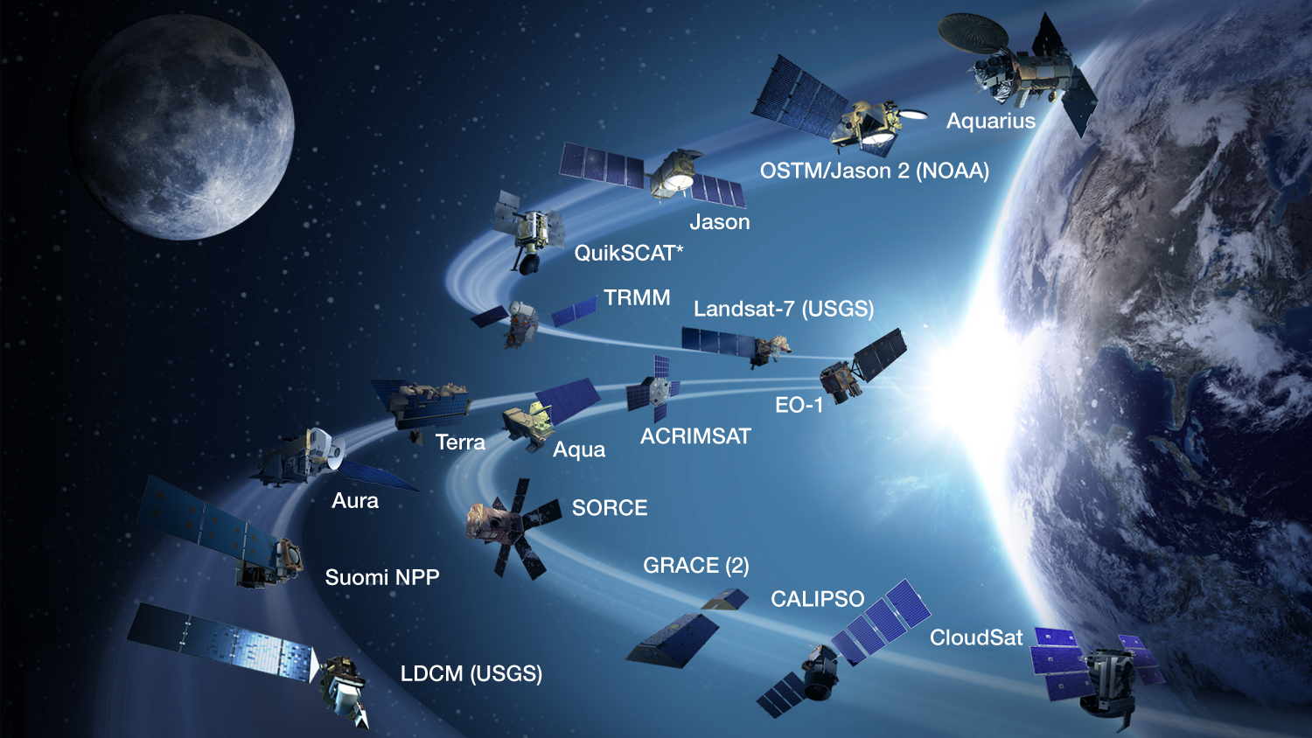
Earth Science at NASA
Earth Science Disciplines
Cryospheric science
Land use/land cover change
Terrestrial ecology
Physical oceanography
Biological oceanography
Terrestrial hydrology
Precipitation science
Atmospheric modeling
27 Operating missions
30 Past missions
8 Under development
6 Under study
7.4 Petabytes of data (average growth: 5.4 TB/day)
1.5 Million distinct users of EOSDIS data and services
Notes:
Table of Missions: http://science1.nasa.gov/earth-science/missions/
EOSDIS System Metrics: https://earthdata.nasa.gov/about-eosdis/performance
Note: Average growth of archive holdings is 5.4 TB/day

Slide 7
D = Distributed…
ASF DAAC
SAR Products
Sea Ice, Polar
Processes
SEDAC
Human Interactions
in Global Change
CDDIS
Crustal Dynamics
Solid Earth
LP DAAC
Land Processes
& Features
GES DISC
Atmos Composition &
Dynamics, Global
Modeling, Hydrology,
Radiance
NSIDC DAAC
Cryosphere, Polar
Processes
OBPG
Ocean Biology &
Biogeochemistry
ORNL DAAC
Biogeochemical
Dynamics, EOS Land
Validation
LAADS/
MODAPS
Atmosphere
PO.DAAC
Physical
Oceanography
GHRC
Hydrological Cycle &
Severe Weather
ASDC
Radiation Budget,
Clouds, Aerosols,
Tropo Chemistry
Notes:
EOSDIS (Earth Observing System Data and Information System) is comprised of 12 DAACs (Distributed Active Archive Centers)

Slide 8
D = Distributed…
ASF DAAC
SAR Products
Sea Ice, Polar
Processes
SEDAC
Human Interactions
in Global Change
CDDIS
Crustal Dynamics
Solid Earth
LP DAAC
Land Processes
& Features
GES DISC
Atmos Composition &
Dynamics, Global
Modeling, Hydrology,
Radiance
NSIDC DAAC
Cryosphere, Polar
Processes
OBPG
Ocean Biology &
Biogeochemistry
ORNL DAAC
Biogeochemical
Dynamics, EOS Land
Validation
LAADS/
MODAPS
Atmosphere
PO.DAAC
Physical
Oceanography
GHRC
Hydrological Cycle &
Severe Weather
ASDC
Radiation Budget,
Clouds, Aerosols,
Tropo Chemistry

Slide 9
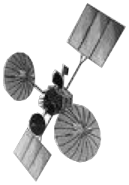
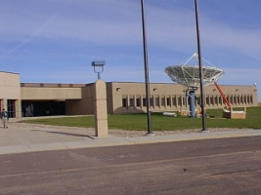
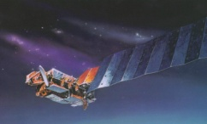
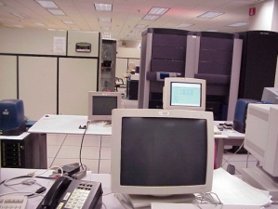
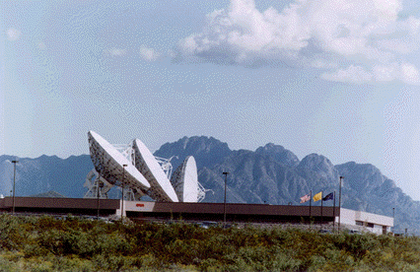
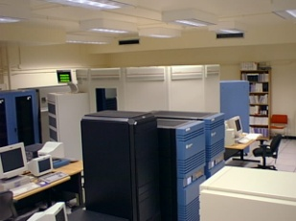
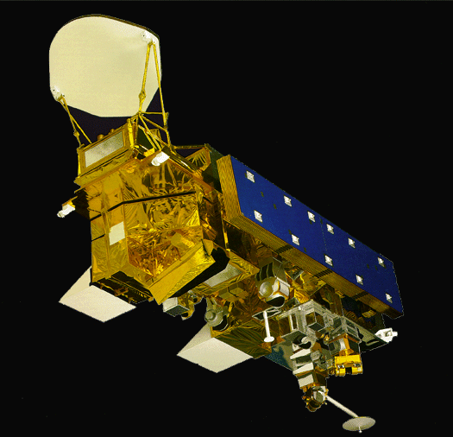
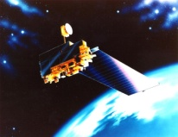
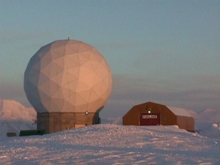
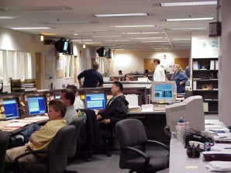
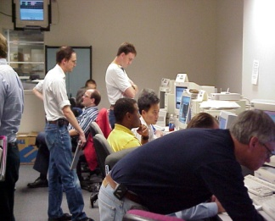
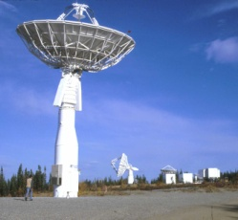
Mission Operations
Science Operations
Data Acquisition
Flight Operations,
Data Capture,
Initial Processing,
Science Data Processing,
Archive, & Distribution
EOS
Tracking & Data Relay Satellite (TDRS)
Spacecraft
Research
Education
White Sands Complex (WSC)
Data and Operations System Data Processing
Data
Centers
Internet
Value-Added
Providers
(Data Search & Access)
EOS Operations Center Mission Control
Interagency
Data Centers
Direct Broadcast (DB)
Earth
System Models
EOS Polar Ground Stations
International
Partners
Instrument Teams
Direct Broadcast/
Direct Readout Stations
Decision Support
Systems
Notes:
DAACs across ESDIS fill a variety of roles in the end to end mission system
From previous slide, dozens of missions and their interface to the EOSDIS DAACs
Note consistent role: Data Stewardship and Support for communities of users

Slide 10
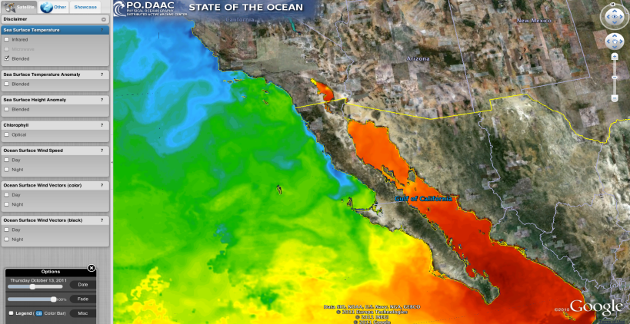
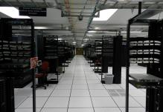
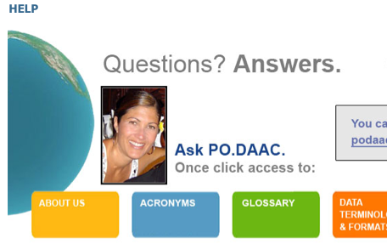
PO.DAAC Functional Areas
Data Management & Stewardship
Data Access
Provide intuitive services to discover, select, extract and utilize data
Preserve NASA’s data for the benefit of future generations
Science Information Services
Provide a knowledgebase to help a broad user community understand and interpret satellite ocean data and related information
Notes:
Will see this slide throughout the day
Physical view
This breakout helps PO.DAAC focus on fulfilling the charter
Data Management and Stewardship
- Data gap analysis
Data Access
- Set of Tools and Services
Science Information Services
- Understanding the data and associated metadata

Slide 11
PO.DAAC Interfaces and Stakeholders
Requirements
NASA HQ
ESDIS
JPL
New Technologies
Best Practices
Requests
Flight Projects
PO.DAAC
ESDSWG
PI Projects
ESIP Clusters
NASA DAACs
DAACs/NODC
UWG
Users
Program Offices
Recommendations

Slide 12
TCAT and the E&E

Slide 13
Technical Capability Assessment Team (TCAT)
Technical Capabilities Assessment Team formed in early 2014
https://nbat.hq.nasa.gov/tcat/index
Purpose was to arrive at a more efficient operating model without compromising core functions or necessary technologies
Question of core functions (what qualifies) is important
Question of what’s necessary (“Given the volatility of national space policy”) is important
Did a number of deep dives, most relevant to us: “Long term data management, as a NASA solution”
TCAT’s analysis of the DAACs spanned a one year period
Initial findings sparked interest, but there were gaps in knowledge that affected the relevance
E&E Review Team formed to have a closer look
Notes:
Deep dives: https://nbat.hq.nasa.gov/tcat/deep_dives

Slide 14
From TCAT to E&E
ESD/ESDIS was assigned to sponsor an independent review team formed to “study potential efficiencies and enhanced capabilities”
E&E Review Team formed April 20, 2015
E&E = Evolution, Enhancement, Efficiency (choose any 2)
ESDIS/DAAC accomplishments were recognized
Strong relationship with science community
Consistently meets stewardship responsibility
Actively promotes early partnerships with data providers
Three findings and associated recommendations were reported out to the DAACs on August 17, 2015

Slide 15
Recommendations

Slide 16
Findings & Recommendations #1
Finding: Commercial cloud environments offer potential for storage, processing, and operations efficiencies; improved cross-DAAC collaboration; and potential for new data access and service paradigms. The ESDIS Project and DAACs have initiated preliminary studies of relevant Cloud technology but these have been ad hoc. Substantial additional work, coordination, and investment is needed in this area to identify opportunities and risks.
Recommendation: The ESDIS Project should develop, implement, and report on the outcome of prototypes to explore the advantages, risks, and costs of using commercial cloud environments for:
Storage and data transfer (e.g., assess benefits and impacts of “virtual data center”, “virtual collections” and costs for distributing data from cloud environments);
Processing (e.g., advantages and effects of elastic computing on cost and speed for processing and reprocessing);
Improved data access (including exploration, selection, reduction, data analytics), and the feasibility associated with enabling data analytics/on-demand processing (e.g., bringing user processing/algorithms closer to the data). An important goal would be enabling user work across multiple large data sets managed by different DAACs without the need to transmit data over networks.

Slide 17
Findings & Recommendations #2
Finding: There are a plethora of tools across the DAACs with varying levels of usability. While many are discipline/data collection unique, there is also considerable overlap, redundancy, and duplication of effort. Redundancy of tools leads to user confusion.
Recommendation: The ESDIS Project should develop, execute and report on efforts to:
Implement common data services and APIs for uniform search, discovery, access to data (common APIs should augment necessary discipline specific tools);
Consolidate and simplify duplicative software tools;
Develop a common software requirement and development strategy across DAACs;
Work towards a uniform user experience across DAACs based on design/development best practices;
The objectives are to ensure the right tools are built; eliminate unnecessary duplication; build with reuse in mind; leverage common web services; release software via Open Source and improve system wide usability.

Slide 18
Findings & Recommendations #3
Finding: There is significant potential for increased collaboration across DAACs through open source software development. However the time and effort required to share software outside the original NASA development organizations, by open sourcing, can be prohibitive. Inability to share software increases cost and inhibits reproducibility of data products.
Recommendation: NASA should develop more streamlined approaches and processes to allow Open Source Software development throughout the agency. Adequate resources need to be applied to ensure that NASA-developed software can be open sourced on a timeline that facilitates collaboration and reuse.

Slide 19
Solution Space

Slide 20
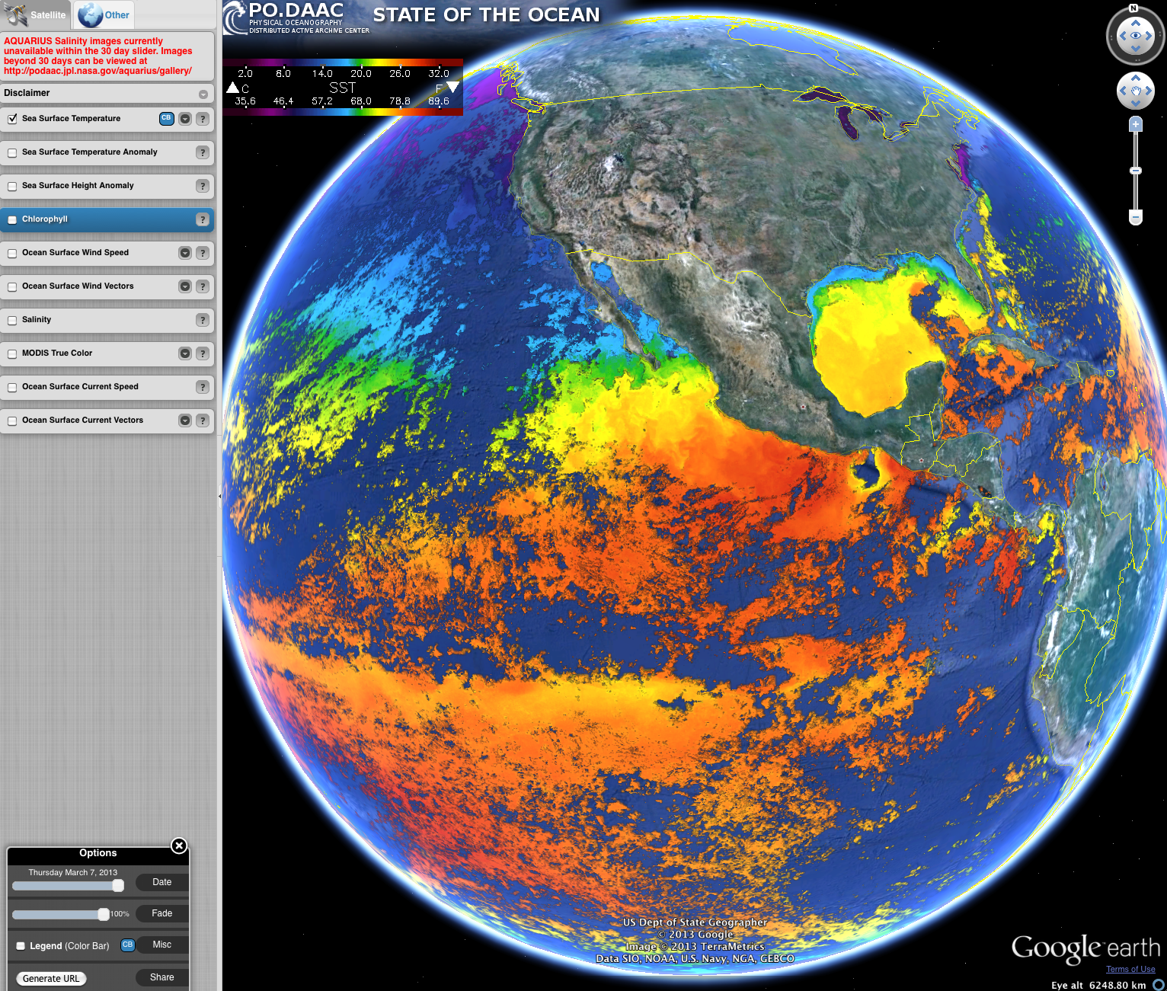
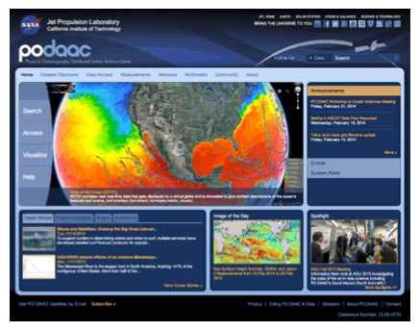
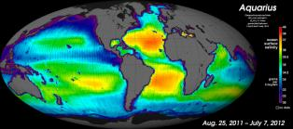
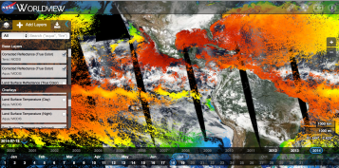
PO.DAAC: Science and Technology Leadership and Innovation
Science Community Leadership
Expertise in gravity data sets, sea surface temperature, salinity, ocean surface topography, ocean currents, ocean winds, ocean circulation
Interface with global array of providers, partners, and user groups
Vital to both the Oceanographic and Climate communities
User and Science information services
Technology Leadership
Advance ESDIS core technologies, e.g., Global Imagery Browse Services (GIBS)
Data discovery and access tools
Extensible Data Gateway Environment (EDGE)
Semantic Web for Earth and Environmental Terminology (SWEET)
State-of-the-Art Visualization technologies
Strong participation in technology proposals to further science investigations
Federation of Earth Science Information Partners (ESIP) long-term Voting Member
NASA Earth Science Data System Working Groups (ESDSWG)
Data-Intensive Architecture (DIA)
Data Quality
Visualization
Digital Object Identifier (DOI)
System Engineering/Data Architecture Leadership
Cloud Computing and Big Data
End-to-end Data System lifecycles
Data Stewardship and Metadata standards
Modular processing pipelines for automation and efficiency

Slide 21
Cloud-based Analytics Platform for the Retrieval of Information (CAPRI)
What is CAPRI (other than an island off the West coast of Italy) ?
PO.DAAC-owned HW/SW asset
Completely independent of PO.DAAC Operations facility
Technology incubator to:
Provide key support for PO.DAAC’s Number One Priority
Empirically demonstrate tradeoffs in building a data analytics platform
Benchmark performance
Support PO.DAAC-related technology proposals
Respond to all 3 TCAT recommendations
What is currently being done?
Use Cases being collected
Hardware being installed and configured
Experiments being defined

Slide 22
Parting Thoughts

Slide 23
Lessons Learned
Soul searching is not a bad thing
Good to look closely at ourselves once in a while.
The recommendations (ultimately) were solid ideas worth examining.
Innovation is worth fighting for
Avoiding redundancy is good; options are good, too.
So far, seems a healthy respect for innovation and competition has not been (completely) lost.
Make sure folks “up the chain” understands who you really are.
Many thought DAACs were just a stack of disks.
Spent quite a bit of energy reminding people what a DAAC is all about.
Seems it finally got through; probably shouldn’t have been necessary to begin with.

Slide 24
BACKUP

Slide 25
DAAC Organizations
 | DAAC Name | DAAC Acronym | DAAC Manager
1 | Alaska Satellite Facility | ASF | Annette (Nettie) La Belle-Hamer
2 | Atmospheric Science Data Center | ASDC | John Kusterer
3 | Land Processes | LP DAAC | Chris Doescher
4 | National Snow and Ice Data Center | NSIDC | Brian Johnson
5 | Oak Ridge National Laboratory | ORNL | Suresh Vannan
6 | Physical Oceanography | PO.DAAC | Rob Toaz
7 | Socioeconomic Data and Applications Center | SEDAC | Bob Chen
8 | Global Hydrology Resource Center | GHRC | Rahul Ramachandran
9 | Ocean Biology Processing Group | OBPG | Gene Feldman
10 | MODIS Adaptive Processing System Level 1 and Atmosphere Archive and Distribution System | MODAPS LAADS | Ed Masuoka
11 | Crustal Dynamics Data Information System | CDDIS | Carey Noll
12 | Goddard Earth Sciences Data and Information Services Center | GES DISC | Steve Kempler

